Slide 1
Basic transformations
Basic transformations

Slide 2
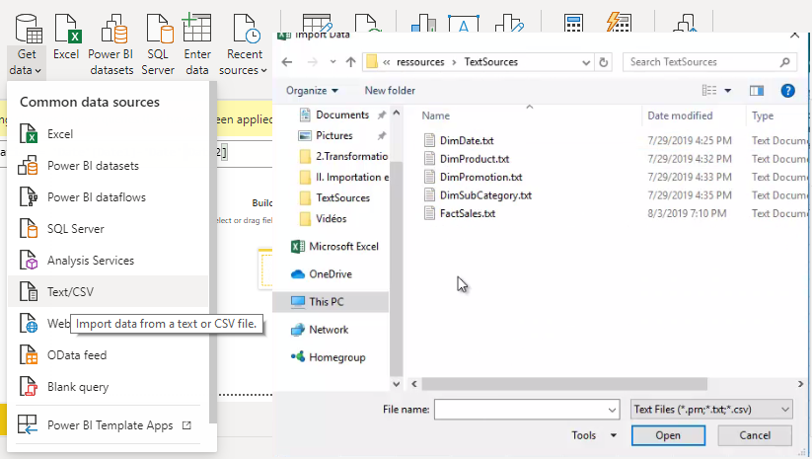
Basic Transformations
Note: This Lab uses the TextSources\FactSales.txt file located in the resources folder
Navigate to the page where the FactSales.txt file is located

Slide 3
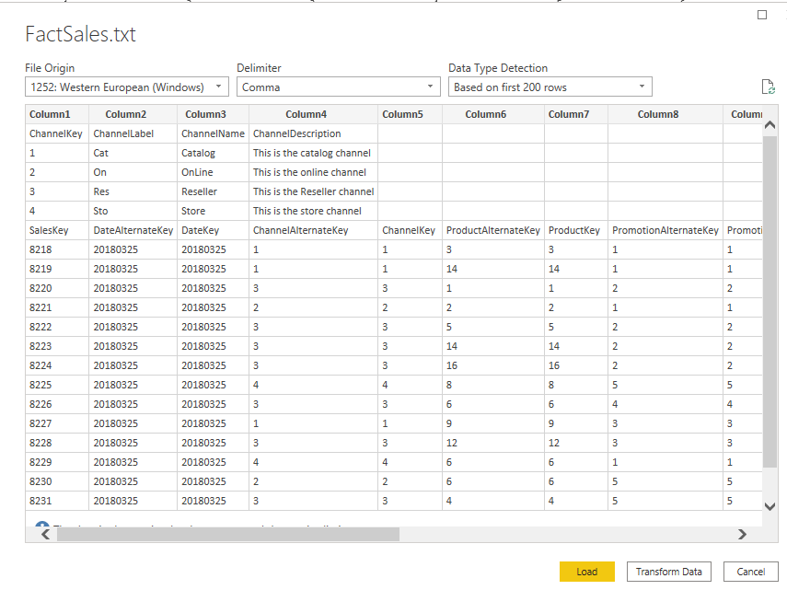
Basic Transformations
Load the file into the editor and notice that the table structure is inconsistent

Slide 4
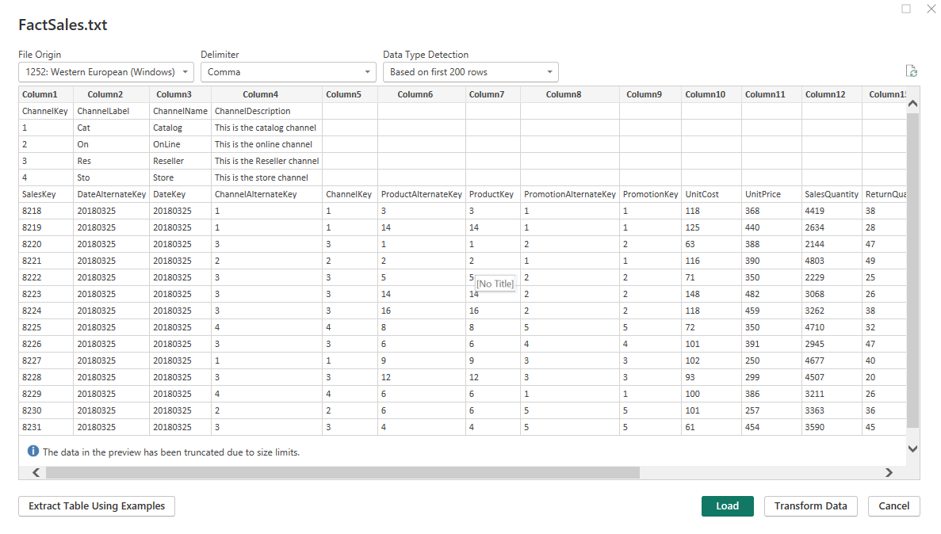
Basic Transformations
Open the query in the Query Editor and

Slide 5
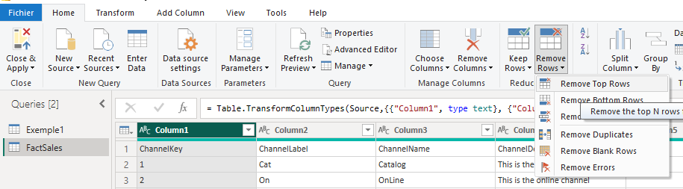
Basic Transformations
Try deleting the first four lines, by selecting Home then Remove Rows > Remove Top Rows

Slide 6
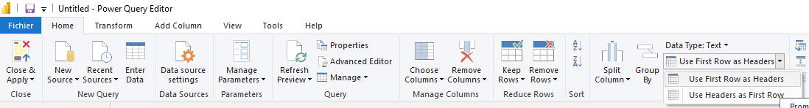
Basic Transformations
Set the first row as a set of column headers

Slide 7
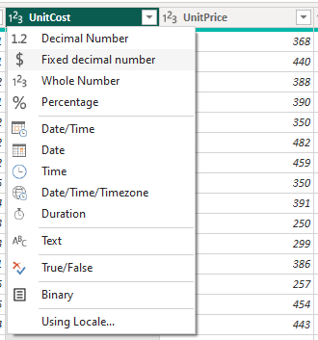
Basic Transformations
Configure the appropriate column types for example UnitCost , UnitPrice,Return , Amount … must be of type currency instead of type number

Slide 8
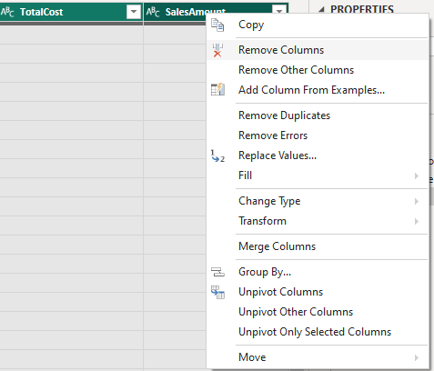
Basic Transformations
Delete empty columns

Slide 9
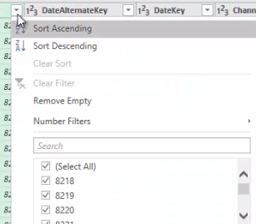
Basic Transformations
Try sorting the data and explore the context menu mentioned below

Slide 10
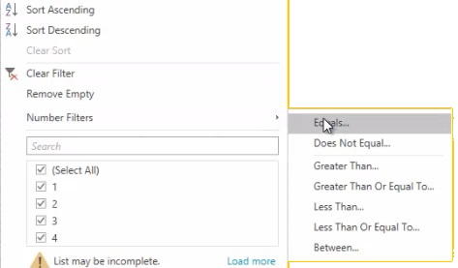
Basic Transformations
Try testing the Number Filters menu
Notice that in the Manufacturer and BrandName columns there are null values.

Slide 11
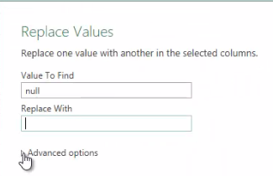
Basic Transformations
Try replacing null values with No manufacturer and No Brand name for Manufacturer and BrandName columns respectively using Replace Values functionality

Slide 12
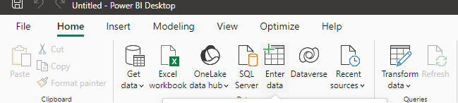
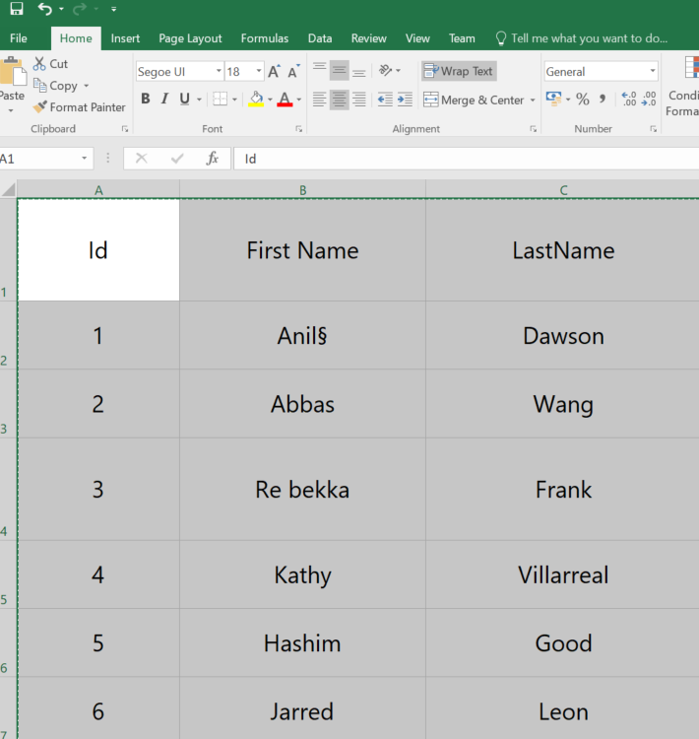
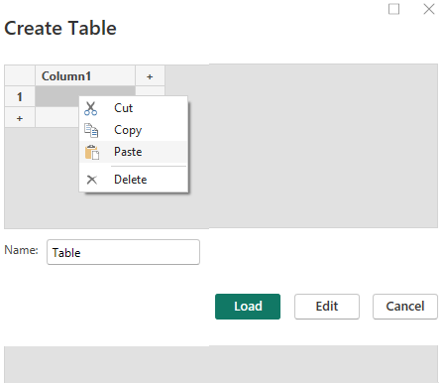
Basic Transformations
Import data into a Names table from Excel to Power Bi
Id | First Name | LastName
1 | Anil§ | Dawson
2 | Abbas | Wang
3 | Re bekka | Frank
4 | Kathy | Villarreal
5 | Hashim | Good
6 | Jarred | Leon

Slide 13
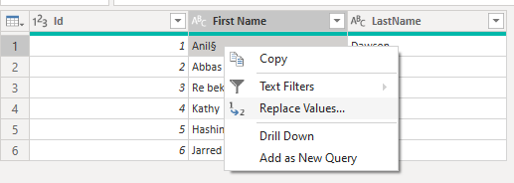
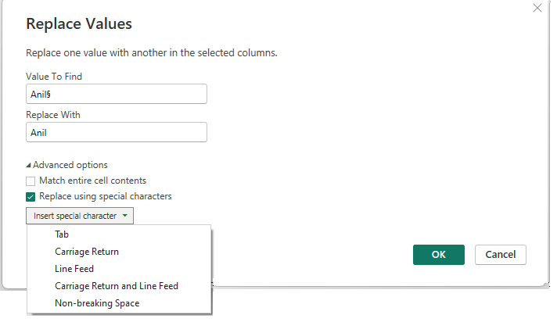
Basic Transformations
Notice that the first line shows a so-called Non-printable character § and on the third line there is an incorrect space in the name as well.
Try to delete the unwanted character
Take a look at the Advanced Options
Try the Replace using special character option

Slide 14
Thank you
Thank you

